Slide 1
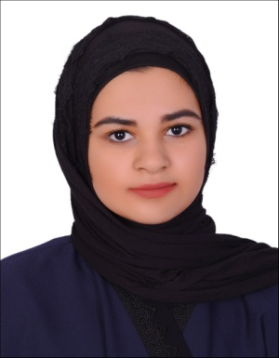
Curriculum Vitae
PERSONAL DETAILS :
Name : Tassnim Mohammed Ali Hassan Habib
Address : Villa486 , Road 2610 , West Eker626
Nationality : Bahraini
CPR : 010608079
Sex : Female
Marital Status : single
Date of Birth : 26th / jun / 2001
Contact No :39768610 \33583659
E-mail : tasneemalshikh3@gmail.com
EDUCATIONAL BACKGRAOUND:
Sitra Secondary School High school .
Experience:
Specialist Processing Assistant in Alsalmaniya Hospital (tow week School curriculum ).
Additional Skills :
Technical Skills
Excellent IT including Microsoft products ( Word,Exal,Powerpoint ,outlook etc ) and research tools ( internet and database use )
Personal Skills
Problem solving skill
Effective communication skill
Attention to detail / accuracy
Friendly and approachable
Effectively mange time
Ability to perform effectively under pressure
Ability to perform under pressure
Ability to build positive working relationships and meet expectations
LANGUGE SKILLS :
Arabic ( fluent – speaking & writing )
English ( good - speaking & writing )
Interest , Hobbies & Activities
Reading
Drawing
cooking
Work in the computer

